Slide 1


Expectations
at

Slide 2
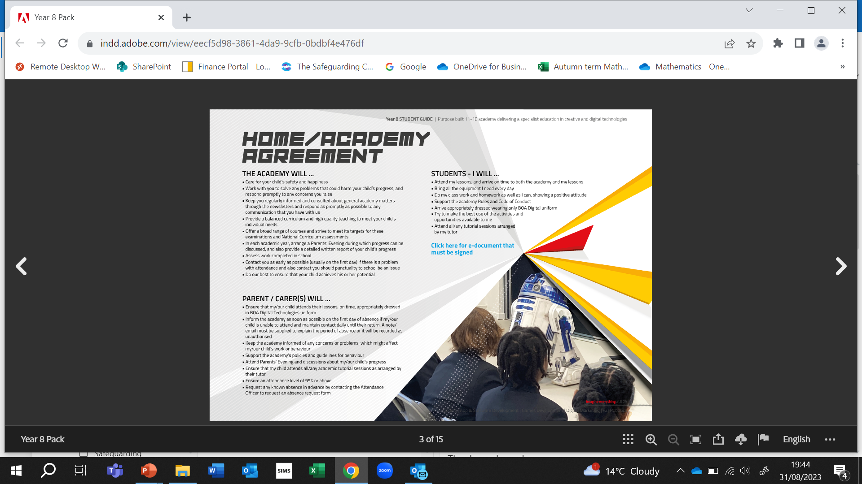

Slide 4

Attendance
Attend my lessons and arrive on time to both
the academy and my lessons
School attendance target is 96%
Lessons start at 9am. You need to be here by 8.55am.
Plan your day. Which books will you need when?
Do not go to your locker between lessons.
Late?
Make up the
time missed
at break or lunch

Slide 5

Equipment
Bring all the equipment every day.
School bag, pen, pencil, ruler, rubber, green pen, calculator,
Water bottle, mobile phone.

Slide 6

Effort
Do my classwork and homework as best as I can, showing a positive attitude.
Remember, at BOA
we like to get ​
D I G I T A L​
Driven
Innovative
Genuine
Independent
Team-Players
Ambitious
Leader
Incomplete
work
Work will be sent
home to complete

Slide 7

Be nice
Support the academy rules and code of conduct.
At BOA Digital we have mutual
respect and demonstrate
kindness towards others.
Be nice!

Slide 8
Language Polite to everyone.
Gestures Smile, think about
your expressions
Be nice!
Actions Helpful, clear plates
respect our environment
Notes:
Good morning,
Use names,
Respect others views and listen to their opinions.

Slide 9
Unsafe and not nice behaviour.
Throwing/pretending to throw items over the balcony/staircase handrails
Unkind behaviour to others regarding things such as race, religion, gender,
sexual orientation or disability.
Theft/vandalism/threatening behaviour/violence/possession of
prohibited items
Unkind behaviour towards staff
Consequence
Tutorial Internal exclusion Suspension Permanent exclusion
Notes:
Age, Disability, Gender reassignment, Race, Religion or belief, Marriage or civil partnership, Sex, Sexual orientation.

Slide 10

Uniform
Arrive appropriately dressed, wearing only the BOA Digital Uniform.
Always look smart, keep your shirt tucked in and your tie on.
in school and out of school.
Footwear must be shoes, not trainers.

Slide 11
Maximise opportunities
Try to make the best use of the activities and
opportunities available to me .
Enrichment after school,
Lunch clubs

Slide 12
Tutorials
Attend all tutorials arranged for me.
Yes a tutorial is because of a mistake but it is an opportunity to
change things.

Slide 13
Be nice!

